Slide 1
Introductory General Chemistry
Chemistry 3A
S. M. Halloran

Slide 2
Quantities
Number | Dimension
1 | mile
3 | teaspoons

Slide 3
Scientific Notation
A way of expressing numerical values
Format: d.mmm × 10^{n}
Part | n.mmm
Part Name | Significand (preferred), Coefficient, (Mantissa is obsolete term)
Part Property | Number greater than or equal to 1.0 and less than 10. This number properly express significant digits
Part | 10^{n}
Part Name | Exponent
Part Property | Exponent of 10 where n is integer, negative, positive (note 10⁰ = 1)

Slide 4
Scientific Notation
decimal point moves to right
1. = 10⁰
10. = 10¹
100. = 10²
decimal point moves to left
0.1 = 10⁻¹
0.01 = 10⁻²
0.001 = 10⁻³
1 atmosphere (atm) = 101,325 Pascals (Pa)

Slide 5
Scientific Notation
Is the number less than 10 and greater than 1?
You don’t really need scientific notation, because it will be [ d.mmm × 10⁰ ] and 10⁰ = 1, so → d.mmm
Otherwise take the number and express as d.mmm
If original number is greater than d.mmm you have to multiply by 10¹ n times to get to original number, so n will be positive (greater than zero): n × 1 = n (greater than zero)
If original number less than d.mmm you have to multiply by 10⁻¹ n times to get to original number, so n will be positive (greater than zero): n × -1 = -n (less than zero)

Slide 6
Scientific Notation
If original number is greater than d.mmm you have to multiply by 10¹ n times to get to original number, so n will be positive (greater than zero): n × 1 = +n
Your book: “if you moved decimal point to the left n places, then n is positive”
35 → 35. → 3.5 moved to left 1 place
3.5 × 10¹
23849 → 23849. → 2.3849 moved to left 4 places
2.3849 × 10⁴

Slide 7
Scientific Notation
If original number less than d.mmm you have to multiply by 10⁻¹ (or divide by 10) n times to get to original number, so n will be negative (less than zero): n × -1 = -n
Your book: “if you moved decimal point to the right n places, then n is negative”
0.0000035 → 3.5 moved to right 6 places
3.5 × 10⁻⁶
0.023849 → 2.3849 moved to right 2 places
2.3849 × 10⁻²

Slide 8
Scientific Notation
Patterns for memorizing
decimal point movement – number being changed – final exponent value
Left – Large – Positive
Right – Small – Negative
Positive and negative for exponent, not significand!
34249 → 3.4249 × 10⁴
-34249 → -3.4249 × 10⁴
0.0034249 → 3.4249 × 10⁻³
-0.0034249 → -3.4249 × 10⁻³

Slide 9
Scientific Notation
Scientific notation is actually a product of two numbers: the significand and a power of 10!
34249 = 3.4249 × 10⁴ = 3.4249 × 10,000 = 34249
-34249 = -3.4249 × 10⁴ = -3.4249 × 10,000 = -34249
0.0034249 = 3.4249 × 10⁻³ = 3.4249 × 0.001 = 0.0034249
-0.0034249 = -3.4249 × 10⁻³ = -3.4249 × 0.001 = -0.0034249
Use this feature to confirm whether you converted a number to scientific notation properly!

Slide 10
Significant Digits
Significant digits indicate the precision, the confidence of a single measurement
Also called significant figures
Measurement/Value | Significant Digits | Explanation
1.7 | 2 | All non-zero digits significant
1.732 | 4
17.32704 | 7 | Zeroes between non-zero digits are significant

Slide 11
Significant Digits
Measurement/Value | Significant Digits | Explanation
0.0045 | 2 | leading zeroes after decimal point not significant
0.00450 | 3 | trailing zeroes after decimal are significant
1200 | 2
1200. | 4 | assertion of decimal point makes significant
0.000 | 0 | no non-zero digits at all
1000.0 | 5 | adding decimal point and any zeroes after it makes all digits significant
100 | 1 | evaluated like the “1200” example above
1.200 × 10⁻³ | 4 | all digits in scientific notation should be significant

Slide 12
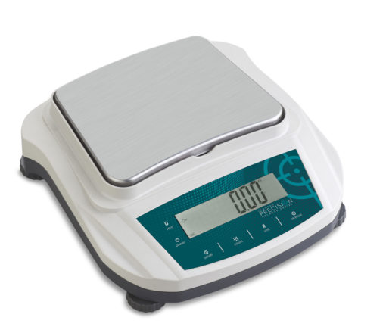
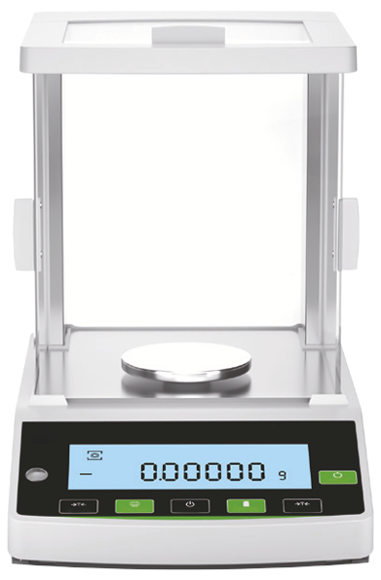
Significant Digits
Significant digits indicate the precision, the confidence of a single measurement
Preparative balance
Measuring quantities usually 0.1 g (100 mg) or greater
used to weigh masses for starting a chemistry experiment
Precision example: 3.4 g sodium chloride (NaCl)
Analytical balance
Measuring quantities usually down to 0.0001 g (0.1 mg or 100 µg) or greater
used to weigh masses for determining yield of product at end of a chemistry experiment
Precision example: 0.0241 g copper(II) sulfate pentahydrate

Slide 13
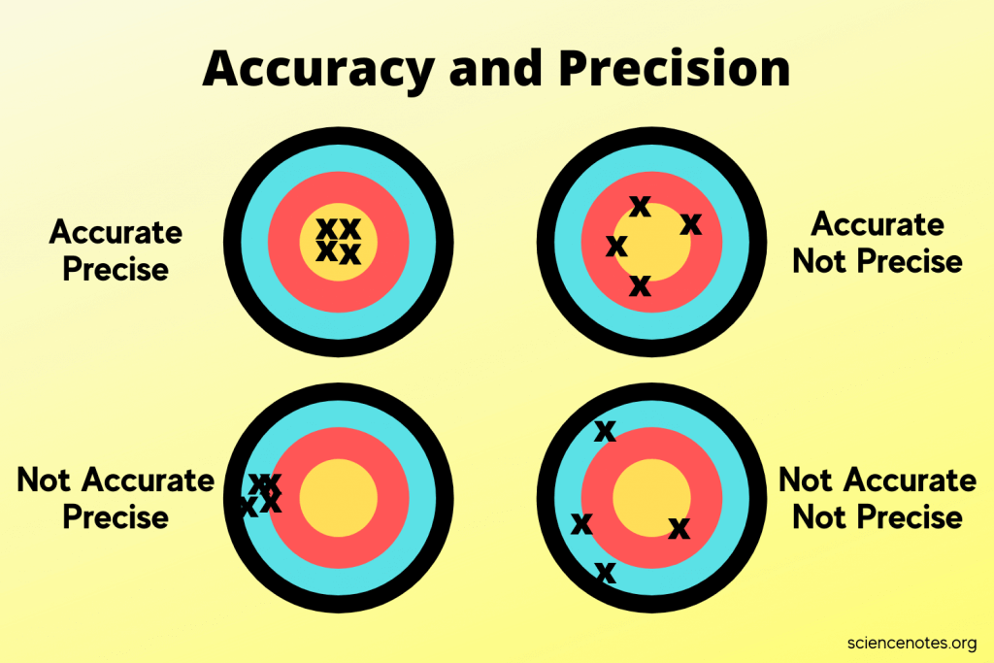
Significant Digits
Multiple Measurements
Precision – an indicator of how measurements repeat the value being measured
Accuracy – an indicator of how measurements get to the true value

Slide 14
Significant Digits in Scientific Notation
The rules on significant digits in numerical values always apply in scientific notation
2.69 × 10⁻⁵ = 0.0000269 (3 significant digits)
2.69000 × 10⁻⁵ = 0.0000269000 (6 significant digits)
2.69 × 10³ = 2690 (3 significant digits)
You still have add the zero to get standard form of number as integer
2.69000 × 10³ = 2690.00 (6 significant digits)

Slide 15
Significant Digits in Scientific Notation
The rules on significant digits in numerical values always apply in scientific notation
2.69 × 10⁻⁵ = 0.0000269 (3 significant digits)
2.69000 × 10⁻⁵ = 0.0000269000 (6 significant digits)
2.69 × 10³ = 2690 (3 significant digits)
You still have add the zero to get standard form of number as integer
2.69000 × 10³ = 2690.00 (6 significant digits)

Slide 16
Doing Calculations: NO INTERMEDIATE ROUNDING!!!

Slide 17
Doing Math
Addition and Subtraction of Numbers with Different Significant Digits
Solve 12.11 + 18.0 + 1.013 =
Solve 100.29 – 2.343 – 72.9 =
Solve 1000.23 – 87.532+ =
 |  |  |  | Result
 |  |  |  | Calculator's Display | Your Answer
Value | 12.11 | 18.0 | 1.013 | 31.123 | 31.1
Decimal Places | 2 | 1 | 3 | 3 | 1
 |  |  |  | Result
 |  |  |  | Calculator's Display | Your Answer
Value | 100.29 | 2.343 | 72.9 | 25.047 | 25.1
Decimal Places | 2 | 1 | 3 | 3 | 1

Slide 18
18 ≠ 18. ≠ 18.0 ≠ 18.00
Addition and Subtraction of Numbers with Different Significant Digits
Solve 12.11 + 18.0 + 1.013 =
Solve 100.29 – 2.343 – 72.9 =
Solve 1000.23 – 87.532+ =
 |  |  |  | Result
 |  |  |  | Calculator's Display | Your Answer
Value | 12.11 | 18.0 | 1.013 | 31.123 | 31.1
Decimal Places | 2 | 1 | 3 | 3 | 1
 |  |  |  | Result
 |  |  |  | Calculator's Display | Your Answer
Value | 100.29 | 2.343 | 72.9 | 25.047 | 25.1
Decimal Places | 2 | 1 | 3 | 3 | 1

Slide 19
Doing Math
Addition and Subtraction of Numbers with Different Significant Digits
Rules of Multiplication and Division

Slide 20
“Conversion Factors”
Calculations in chemistry frequently require converting between the dimensions of a quantity
Volume: fluid ounces to milliliter (“fl oz” to “ml”)
Temperature: Celsius to Kelvin (“°C” to “K”)
Pressure: torr to atmosphere (“torr” to “atm”
Conversions not just about measurement systems but also include scales which are powers of 10
1 liter (L) = 1000 milliliters (ml, sometimes mL)
1 kilogram (kg) = 1000 grams (g)

Slide 21
Conversion Nomenclature
Prefix | Meaning | Example
Multiple of 10 (greater than 1)
kilo- (k) | 10³ = 1000 | 2 kilograms (kg) = 2000 grams
mega- (M) | 10⁶ = 1,000,000 | 3.7 megajoules (MJ) = 3,700,000 J
giga- (G) | 10⁹ = 1,000,000,000 | 10 gigahertz (GHz) = 10,000,000,000 Hz
Submultiples of 10 (fractions of 1)
deci- (d) | 10⁻¹ = 1/10 | 1 deciliter (dL, dl) = 0.1 L
centi- (c) | 10⁻² = 1/100 | 2.54 centimeter (cm) = 0.0254 m
milli- (m) | 10⁻³ = 1/1000 | 14 millibar (mbar) = 0.014 bar
micro- (u/µ) | 10⁻⁶ = 1/1000000 | 259 microliters (µl, ul, µL, uL) = 0.000259 L
nano- (n) | 10⁻⁹ = 1/1000000000 | 34 nanograms (ng) = 0.000000034 g
pico- (p) | 10⁻¹² = 1/100000000000 | 250 picoliters (pL) = 0.00000000025 L
femto- (f) | 10⁻¹⁵ =1/ 1000000000000000 | 4.3 femtomoles (fmol) = 0.0000000000000043 mol
Dimensions in green are often used in chemistry

Slide 22

Density
How much mass is in a given volume
The math definition:
Greek letter rho (ρ) is symbol for density
$$density= \frac{mass}{volume}$$
$$ρ=\frac{m}{V}$$

Slide 23
Temperature
A measure of the average kinetic energy of particles in a substance
Not energy itself, but an indicator or measure of energy

Slide 24
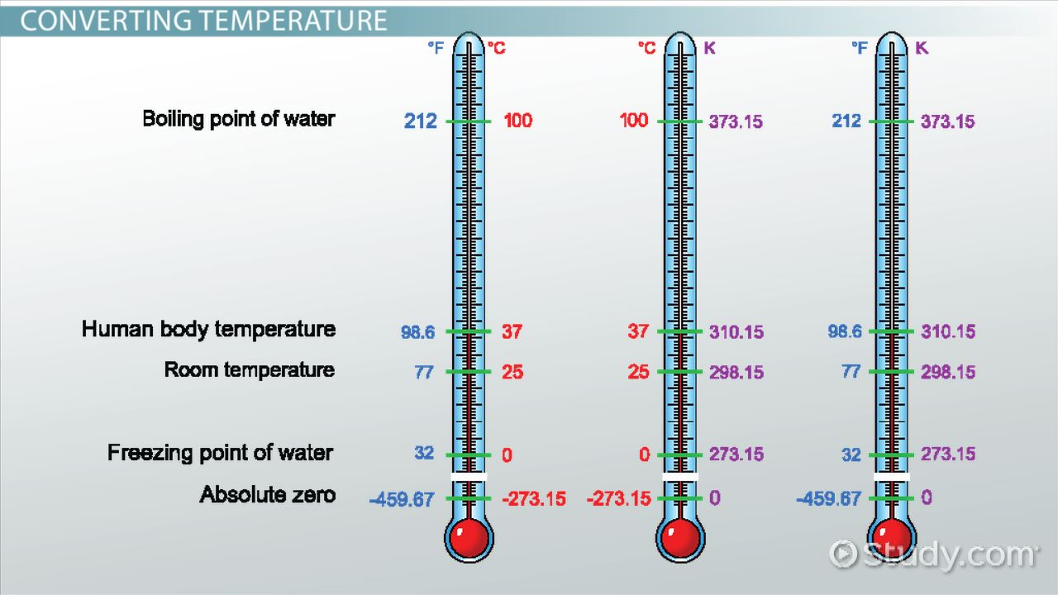
Measuring Temperature
image from Study.com

Slide 25
Temperature Scales
Three scales (measurement types) are used to get a value of temperature
Thermometers usually involve expansion or contraction of calibrated sealed tube of mercury (Hg) or dyed-alcohol
Scale | Water Property
 | freezing point | boiling point
Fahrenheit | 32° F | 212° F
Celsius (centigrade) | 0° C | 100° C
Kelvin | 273 K | 373 K

Slide 26




Converting Temperature
Conversions apply basic algebraic principles of sloped lines
s$\text{lope} =\frac{373 −273}{100 − 0}$ = 1
$$°C =K −273$$
2$73 =1 ×0+\text{intercept}$
Intercept = 273
K$=°C+273$

Slide 27


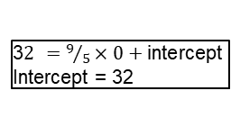

Converting Temperature
Fahrenheit not used in chemistry, but be prepared to convert.
s$\text{lope} =\frac{212 −32}{100 − 0}=\frac{180}{100}=\frac{9}{5}$
$$°C =\frac{5}{9}\left(°F −32\right)$$
3$2 =9/5×0+\text{intercept}$
Intercept = 32
°$F =\frac{9}{5}°C+32$

